Slide 1

MQTT Workshop
By : Herm lecluse & tom verstraten
Notes:
tom

Slide 2
MQTT
Message Queue Telemetry Transport
IoT
Ideal for m2m
Protocol
TCP based
Notes:
tom

Slide 3
Some specifics
Topic
Publish/Subscribe based
Lightweight
Broker/client
Notes:
Herm tekenen

Slide 4
Publish/ Subscribe
Client subscribes to a topic on the broker
Can be any given name
Paths are recommended
Using paths, wildcards can be used (#)
Client will receive any message sent in one of the subscribed topics.
Publish will send a message to all subscribers
Notes:
herm

Slide 5
Why MQTT?
Simple to implement
Central broker
QoS, More on that in the next slide
Subscription Pattern for easy filtering
Extremely Lightweight
Ideal for low bandwidth/high latency networks
Continuous Session Awareness
Can be encrypted using SSL/TLS
Notes:
tom

Slide 6
Qos
QoS 0 – at most once PUBLISH
Fire and forget
QoS 1 – at least once PUBLISH → PUBACK
Message delivery is confirmed by receiver.
After given time broker will retry sending
QoS 2 PUBLISH → PUBREC PUBREL → PUBCOMP
Safest and slowest
Message will only be delivered once
Notes:
Tom Tekenen

Slide 7
Other features
Persistent sessions → subscribed topics and queued messages will be stored on reconnect
Last Will
Notify other devices
Keep Alive
Notes:
herm

Slide 8
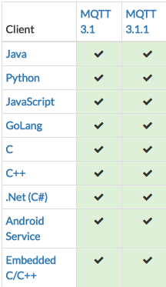
frameworks
PAHO eclipse – client
Open Source client implementation
Mosquitto – broker
Open source broker implementation
Also provides a Raspberry implementation!
Low power devices
Pre-implemented MQTT protocol.
Notes:
herm

Slide 9
Connecting a client
Create a new PAHOClient and connect this to a broker address.
Call the connect method
Notes:
tom

Slide 10
Subscribing to a Topic / Publishing
Create a new ChatCallback
Subscribe to a topic and include the ChatCallback
Add the object as listener to receive message events.
Simply call the Publish method with a Topic and a Message to send a message
Notes:
tom

Slide 11
Exercise
Open the exercise using GitHub
Use classmates and experiment using the client.
MQTTLens is a really cool Chrome plug-in to check if your implementation functions as requested.
You can also set up your own mosquito broker.
Follow the guide for your OS at : https://mosquitto.org/download/

Slide 12
Thank you!
Thank you for participating in this workshop.

